Slide 1

Clean Plate
Presented by
Joey Cam
Violet Huang
Elle Hacks 2021

Slide 2
The Team
Violet
Student from McMaster University in her third year of Software Engineering Technology program
Joey
Student from Sheridan College in her last year of Software Development program

Slide 3
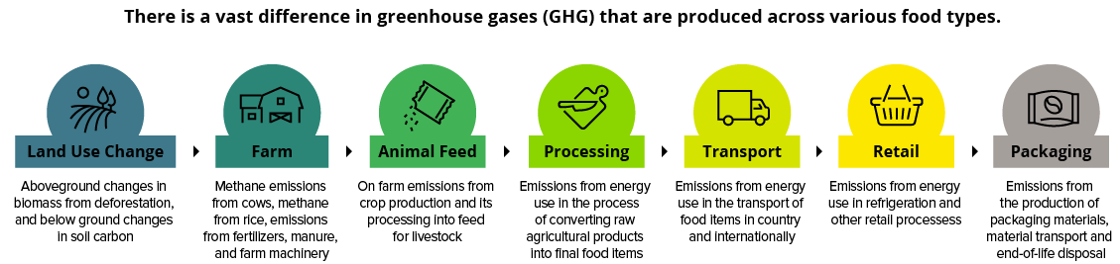
The Problem
Environmental changes happen faster than humans expect
Greenhouse gas emissions across the food supply chain
Food waste seriously impacts our environment
Notes:
One of the biggest problems is dealing with food waste. According to National Zero Waste Council of Canada, 11.2 million metric tonnes of avoidable food loss and waste occurs in Canada each year (That’s about 28000 blue whales). It is found that consumers often discard food without considering the economic or environmental implications whic

Slide 4
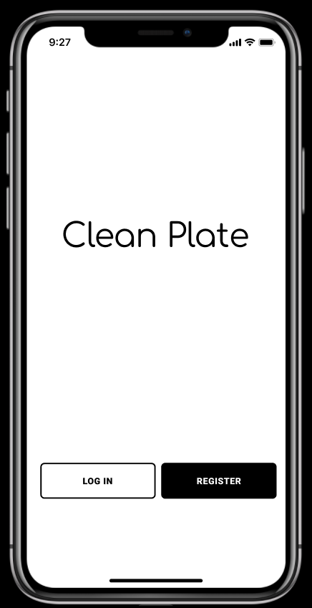
The Solution
Target to minimize the food waste
Keep track of food waste during daily meal
Acknowledge the carbon footprint of particular food item

Slide 5
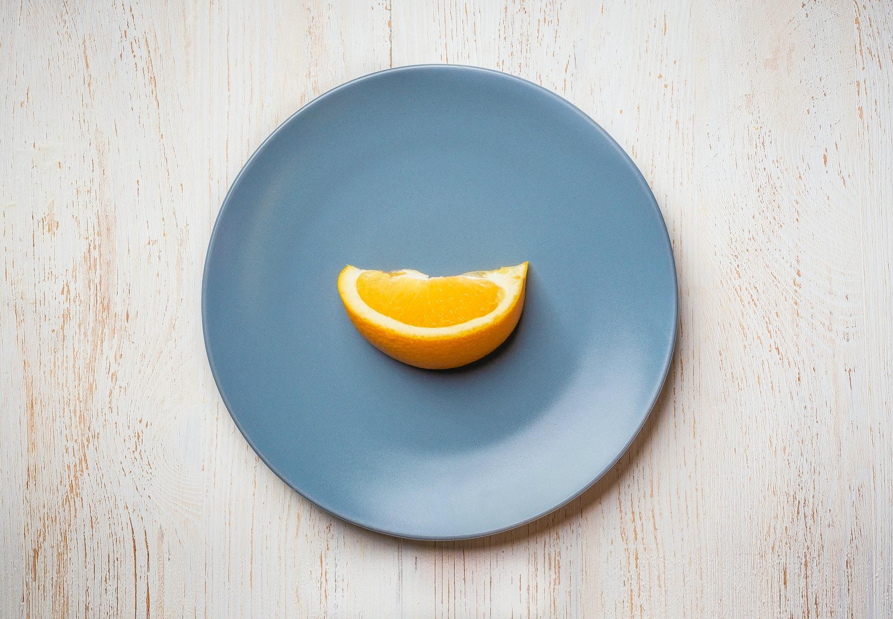
The Unique Value Proposition
Save food, save money from you wallet
Improve a better dining habit
Produce less Greenhouse Gas and limit a large carbon footprint
Notes:
Clean Plate will provide the user feedback with statistics to show them information about their food waste and the breakdown of it.
Besides the app keeps track their daily habit, these reports help to review their dining habit. And it’s sustainable to save food and protect our environment.
What is the incentive for users using this??
Money saving, better dining habit, protect the environment

Slide 6
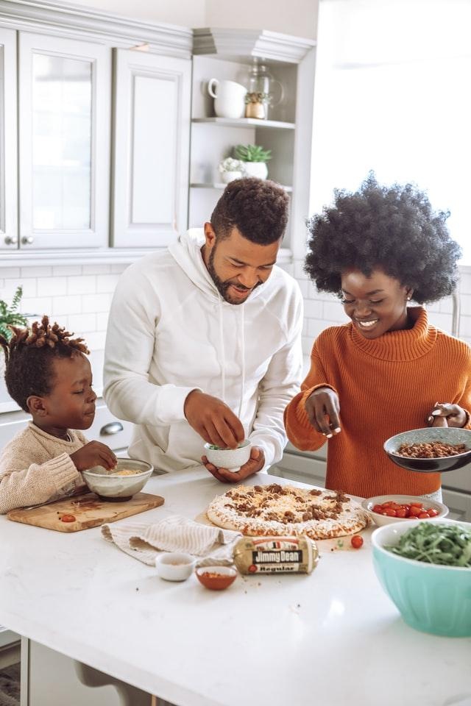
The Customer Segments
Families, especially those with young children
Notes:
our app
Target Audience:
Families curious about their food waste and the consequence of their actions. It gives them a visual and statistical understanding
helps them track their food consumption and from that educate their children about the importance of food waste
at the time when they play with the app, they can educate their children about the importance of food waste

Slide 7
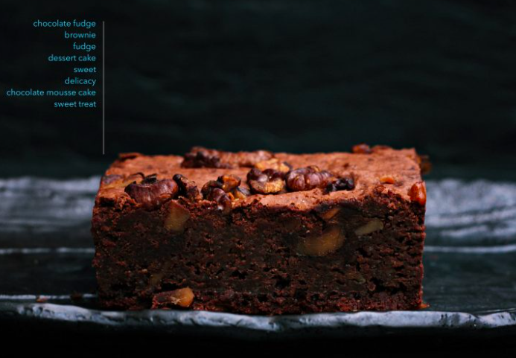
The Technical Aspect
Visual Recognition Pre-trained Object detection model
Mobile Development platform of choice
Notes:
Using IBM Waston’s Visual Recognition Pretrained Object detection model that can detect food, as current they provide over 2,000 tags about food.
Using Mobile Development to allow user’s the ease to capture the image of their food items on their phones, currently we chose android

Slide 8
The Revenue
Cooperate with school boards to extend the science classroom to home and receive funding for long term development
Implement in other health apps to keep track of the dining habits
Notes:
as an edu app, we’d like Cooperate with school boards

Slide 9
The Cost of Operation
Cost to use the continual visual recognition service
Application maintenance
Development investment to new features

Slide 10
The Demo
Notes:
https://www.figma.com/proto/B6eXzEnQoYt5unOfTKSJxc/Prototyping-in-Figma?node-id=0%3A2&viewport=-4628%2C-269%2C1&scaling=scale-down

Slide 11
Future Development Goals
Accurately capture the amount of food waste to:
curate effective solutions for every individual app user
further educate users to allow them to make goals to reduce food waste
Notes:
Being able to capture the amount of waste is nice in the future development to allow users to make goals? learn tips? to help them reduce their waste?
Scaling the app to curate effective solution for the user to reduce any waste, such as buying more/less of certain foods
Complete the full development of an app

Slide 12
The Recap
Target to minimize the food waste
Play, learn, protect

Slide 13
The Reference
The Carbon Footprint of the Food Supply Chain
https://www.visualcapitalist.com/visualising-the-greenhouse-gas-impact-of-each-food/
Tackling Climate Change through Livestock
A global assessment of emissions and mitigation opportunities
Food and Agriculture Organization of the United Nations
Rome 2013
http://www.fao.org/3/i3437e/i3437e00.htm

Slide 14
